Slide 1
Chapter 5
IPv4 Addresses

Slide 2
Outlines
Introduction
Classful addressing
Classless addressing
Special Addresses
NAT

Slide 3
5.1
INTRODUCTION
The McGraw-Hill Companies, Inc., 2000

Slide 4
Introduction
IP address, or Internet Address
  The address of the interface
  32-bit long
  Uniquely and universally defines the connection of a host or a router to the Internet
Address Space
  Total number of addresses used by the protocol
  IPv4 uses 32-bit address and the address space is 2^32

Slide 5
Notation
Binary notation
Dotted-decimal notation
Hexadecimal notation

Slide 6
Binary Notation
01110101 10010101 00011101 11101010
The McGraw-Hill Companies, Inc., 2000

Slide 7
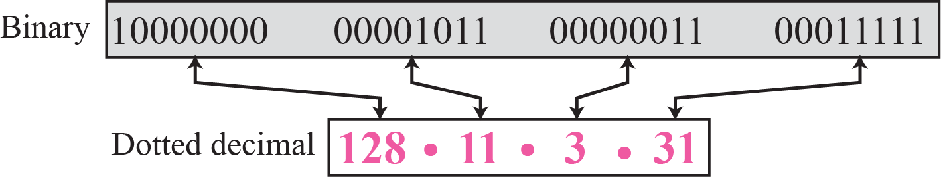
Figure 4-1
Dotted-Decimal Notation
The McGraw-Hill Companies, Inc., 2000

Slide 8
Hexadecimal Notation
0111 0101 1001 0101 0001 1101 1110 1010
75 95 1D EA
0x75951DEA
The McGraw-Hill Companies, Inc., 2000

Slide 9
Example 5.1
Change the following IPv4 addresses from binary notation to dotted-decimal notation.
a. 10000001 00001011 00001011 11101111
b. 11000001 10000011 00011011 11111111
c. 11100111 11011011 10001011 01101111
d. 11111001 10011011 11111011 00001111
Solution
We replace each group of 8 bits with its equivalent decimal number (see Appendix B) and add dots for separation:
a. 129.11.11.239
b. 193.131.27.255
c. 231.219.139.111
d. 249.155.251.15

Slide 10
Example 5.2
Change the following IPv4 addresses from dotted-decimal notation to binary notation.
a. 111.56.45.78
b. 221.34.7.82
c. 241.8.56.12
d. 75.45.34.78
Solution
We replace each decimal number with its binary equivalent:
a. 01101111 00111000 00101101 01001110
b. 11011101 00100010 00000111 01010010
c. 11110001 00001000 00111000 00001100
d. 01001011 00101101 00100010 01001110

Slide 11
Example 5.3
Find the error, if any, in the following IPv4 addresses:
a. 111.56.045.78
b. 221.34.7.8.20
c. 75.45.301.14
d. 11100010.23.14.67
Solution
a. There should be no leading zeroes (045).
b. We may not have more than 4 bytes in an IPv4 address.
c. Each byte should be less than or equal to 255.
d. A mixture of binary notation and dotted-decimal notation.

Slide 12
Example 5.4
Change the following IPv4 addresses from binary notation to hexadecimal notation.
a. 10000001 00001011 00001011 11101111
b. 11000001 10000011 00011011 11111111
Solution
We replace each group of 4 bits with its hexadecimal equivalent. Note that 0X (or 0x) is added at the beginning or the subscript 16 at the end.
a. 0X810B0BEF or 810B0BEF₁₆
b. 0XC1831BFF or C1831BFF₁₆

Slide 13
Example 5.5
Find the number of addresses in a range if the first address is 146.102.29.0 and the last address is 146.102.32.255.
Solution
We can subtract the first address from the last address in base 256. The result is 0.0.3.255 in this base. To find the number of addresses in the range (in decimal), we convert this number to base 10 and add 1 to the result..

Slide 14
Example 5.6
The first address in a range of addresses is 14.11.45.96. If the number of addresses in the range is 32, what is the last address?
Solution
We convert the number of addresses minus 1 to base 256, which is 0.0.0.31. We then add it to the first address to get the last address. Addition is in base 256.

Slide 15
Operations
Bitwise NOT operation
Bitwise AND operation
Bitwise OR operation

Slide 16
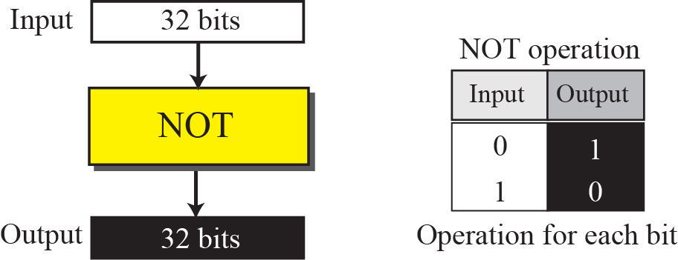
Bitwise NOT Operation

Slide 17
Example 5.7

Slide 18
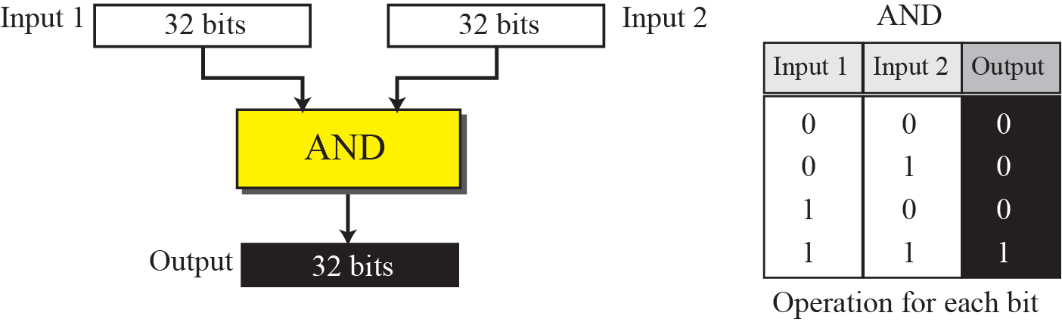
Bitwise AND Operation

Slide 19
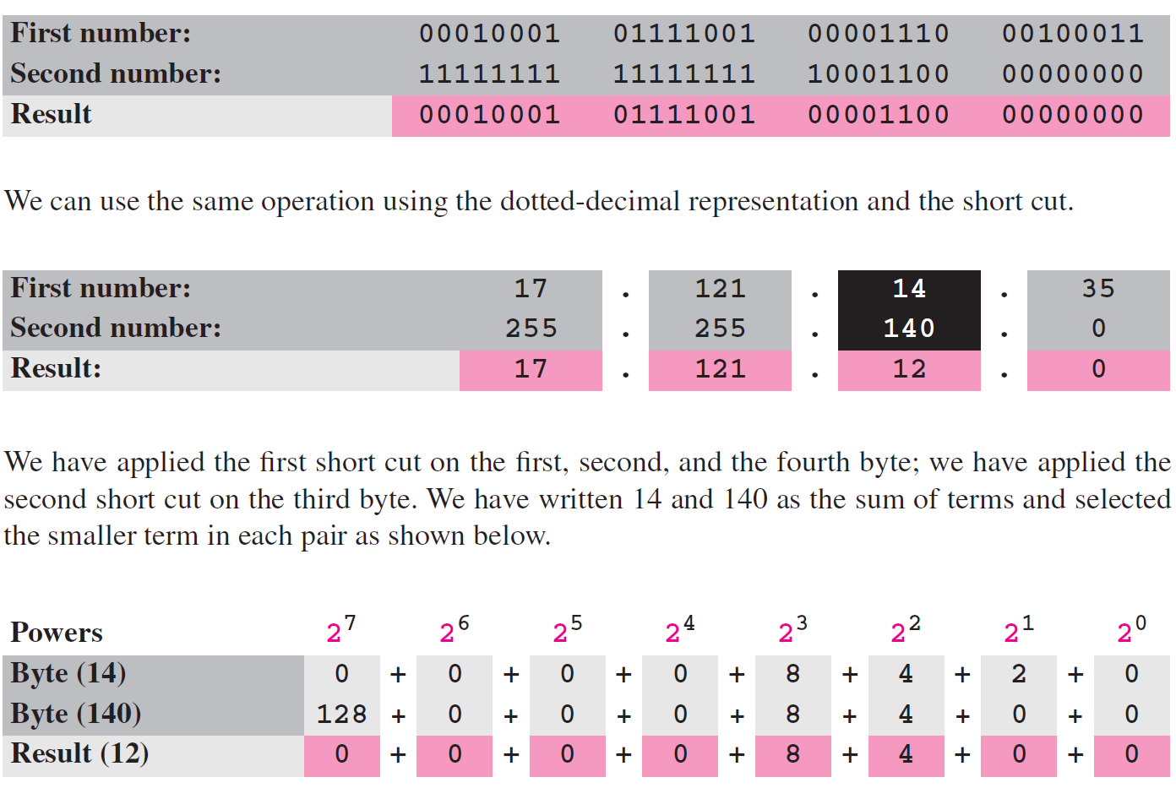
Example 5.8

Slide 20
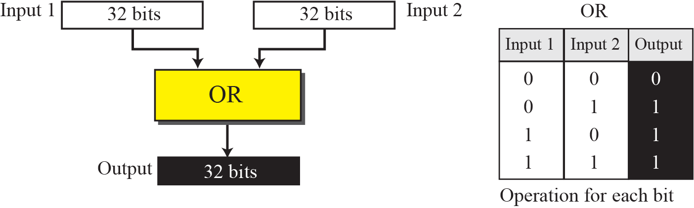
Bitwise OR Operation

Slide 21
Example 5.9

Slide 22
4.2
CLASSFUL
ADDRESSING
The McGraw-Hill Companies, Inc., 2000

Slide 23
Classful Addressing
IP address space is divided into five classes: A, B, C, D, E
  A: 1/2
  B: 1/4
  C: 1/8
  D: 1/16
  E: 1/16

Slide 24
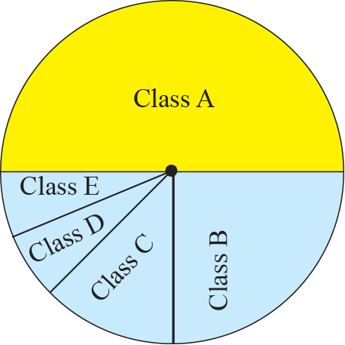
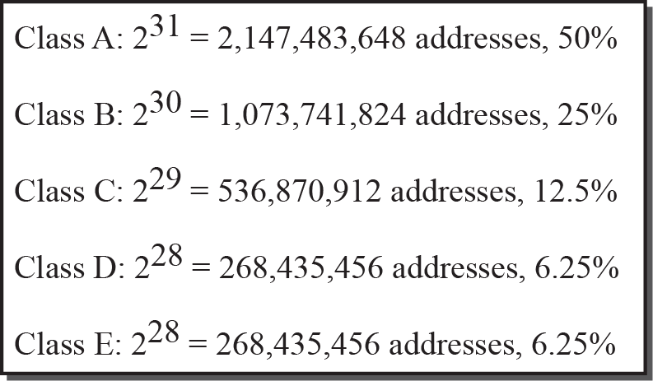
Figure 4-2
Occupation of the Address Space
The McGraw-Hill Companies, Inc., 2000

Slide 25
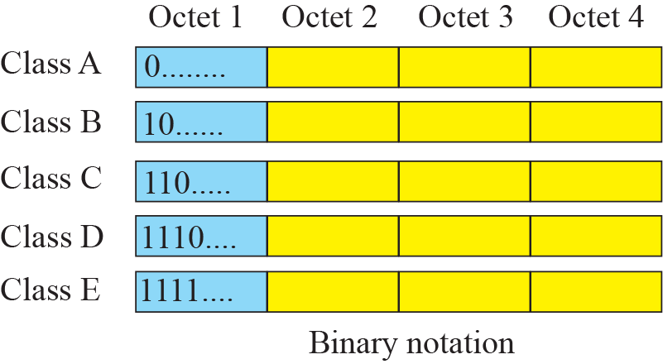
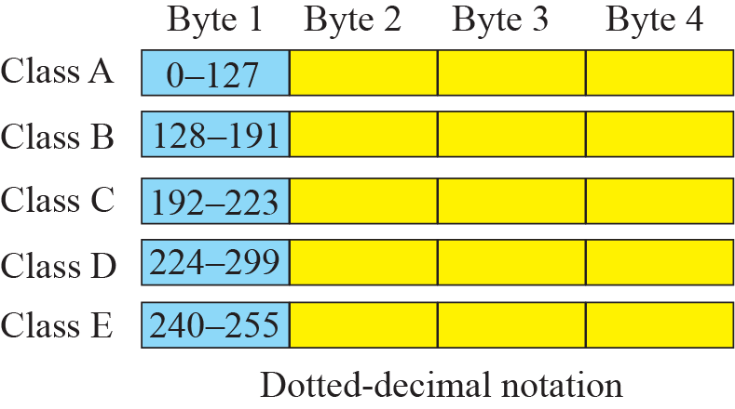
Figure 4-4
Finding the Address Class
The McGraw-Hill Companies, Inc., 2000

Slide 26
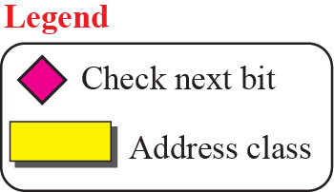
Finding the Class of an Address Using Continuous Checking

Slide 27
Example 5.10
Find the class of each address:
a. 00000001 00001011 00001011 11101111
b. 11000001 10000011 00011011 11111111
c. 10100111 11011011 10001011 01101111
d. 11110011 10011011 11111011 00001111
Solution
See the procedure in Figure 5.7.
a. The first bit is 0. This is a class A address.
b. The first 2 bits are 1; the third bit is 0. This is a class C address.
c. The first bit is 1; the second bit is 0. This is a class B address.
d. The first 4 bits are 1s. This is a class E address.

Slide 28
Example 5.11
Find the class of each address:
a. 227.12.14.87
b. 193.14.56.22
c. 14.23.120.8
d. 252.5.15.111
Solution
a. The first byte is 227 (between 224 and 239); the class is D.
b. The first byte is 193 (between 192 and 223); the class is C.
c. The first byte is 14 (between 0 and 127); the class is A.
d. The first byte is 252 (between 240 and 255); the class is E.

Slide 29
Netid and Hostid
An IP address in classes A, B, C is divided into
  Netid
  Hostid
Notably, classes D and E are not divided into netid and hostid
The McGraw-Hill Companies, Inc., 2000

Slide 30
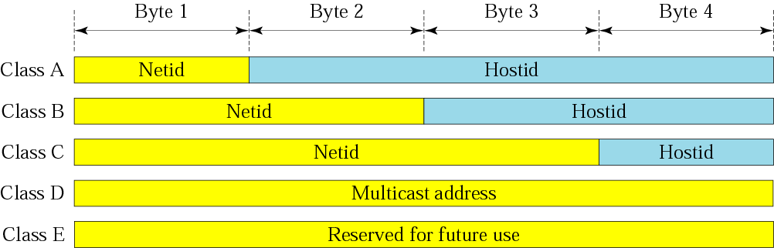
Figure 4-6
Netid and Hostid
The McGraw-Hill Companies, Inc., 2000

Slide 31
Classes and Blocks
Each class is divided into a fixed number of blocks with each block having a fixed size
The number of blocks is based on the netid
Each block’s size is depends on the hostid

Slide 32
Class A
Class A: divided into 128 blocks
  First block: 0.0.0.0 ~ 0.255.255.255
  ….
  Last block: 127.0.0.0 ~ 127.255.255.255
Each block contains 16777216 addresses
  Too large than the needs of almost all organizations
In each block, the first address, e.g., 73.0.0.0, is called the network address
  Identify the network of the organization, not individual hosts

Slide 33
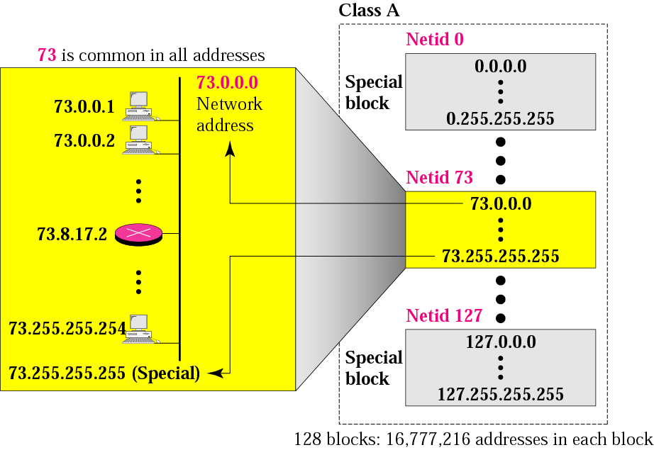
Figure 4-7
Blocks in Class A
The McGraw-Hill Companies, Inc., 2000

Slide 34
Class B
Class B: divided into 16,384 blocks
  First block: 128.0.0.0 ~ 128.0.255.255
  ….
  Last block: 191.255.0.0 ~ 191.255.255.255
Each block contains 65,536 addresses
  larger than the needs of most mid-size organizations
In each block, the first address, e.g., 180.8.0.0, is called the network address
  Identify the network of the organization, not individual hosts
The McGraw-Hill Companies, Inc., 2000

Slide 35
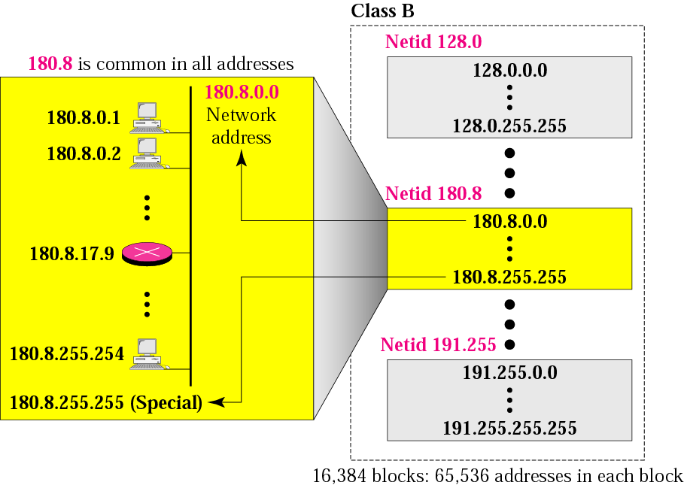
Figure 4-8
Blocks in Class B
The McGraw-Hill Companies, Inc., 2000

Slide 36
Class C
Class C: divided into 2,097,152 blocks
  First block: 192.0.0.0 ~ 192.0.0.255
  ….
  Last block: 223.255.255.0 ~ 223.255.255.255
Each block contains 256 addresses
  Most organizations do not want such a block
In each block, the first address, e.g., 200.11.8.0, is called the network address
  Identify the network of the organization, not individual hosts

Slide 37
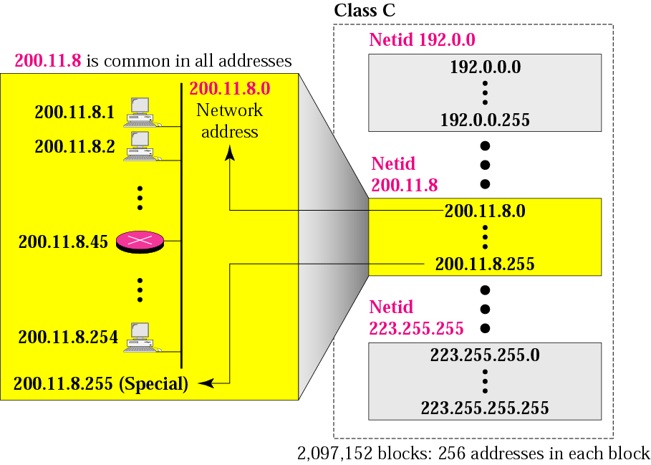
Figure 4-9
Blocks in Class C
The McGraw-Hill Companies, Inc., 2000

Slide 38
Class D and Class E
Class D
  Just one block
  Designed for multicasting and each address is used to identify one multicasting group
Class E
  Just one block
  Designed for use as reserved addresses

Slide 39
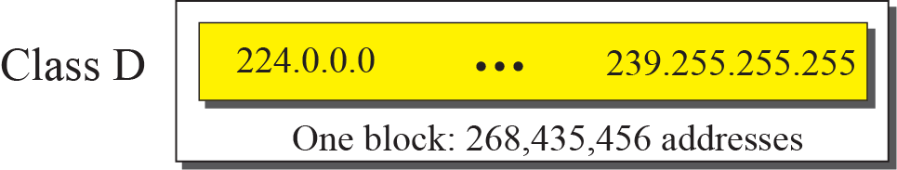
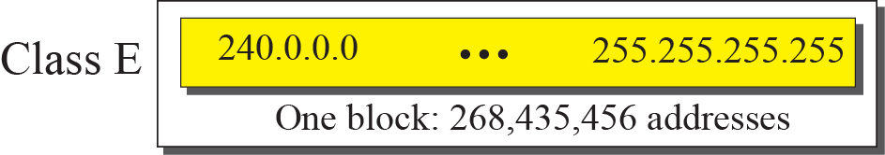
The Single Block in Class D and E

Slide 40

Note
Millions of class A addresses
are wasted.
Many class B addresses are wasted.
Not so many organizations are so small to have a class C block.
Class D addresses are made of one block, used for multicasting.
The only block of class E addresses was reserved for future purposes.

Slide 41
Two-Level Addressing
When classful addressing was design, assumed that the whole Internet
  Divided into many networks
  Each network connects many host
Thus,
  Netid defines the network
  Hostid defines a host connected to that network

Slide 42
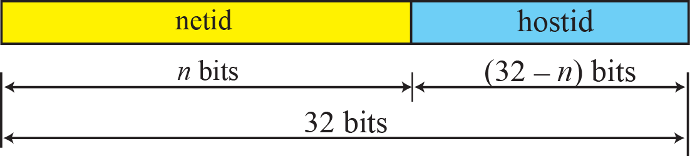
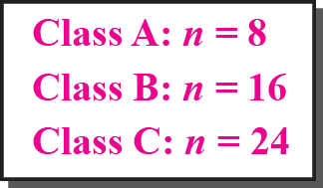
Two-Level Addressing in Classful Addressing

Slide 43
Example 5.12

Slide 44
Extracting Information in a Block
Given any address in the block, we like to know three pieces of information
  The number of addresses in the block
  The first address in the block
  The last address in the block

Slide 45
Extracting Information in a Block (Cont.)
Solutions: find the class of the address and the length of netid is n
Question 1: the number of addresses in the block ?
  N = 2^{32-n}
Question 2: the fist address in the block ?
  Keep the n leftmost bits and set the (32-n) rightmost bits all to 0s
Question 3: The last address in the block ?
  Keep the n leftmost bits and set the (32-n) rightmost bits all to 1s

Slide 46
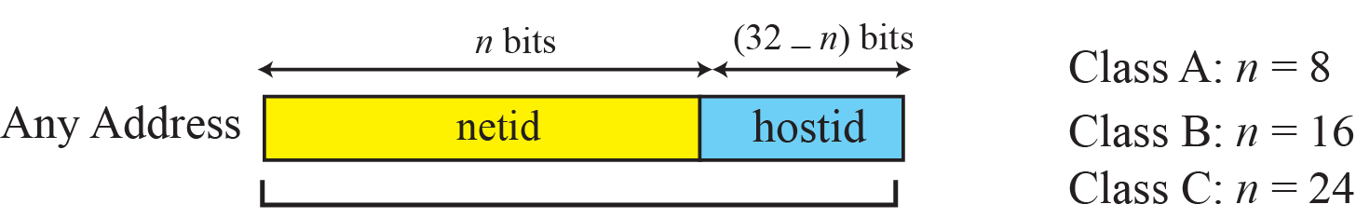
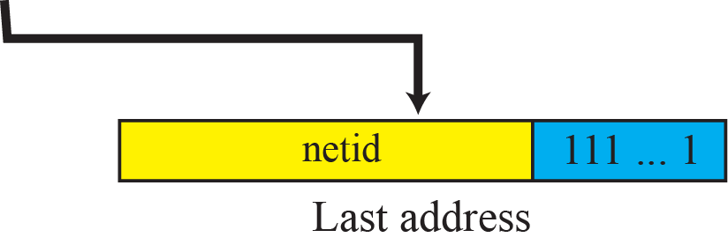
Information Extraction in Classful Addressing

Slide 47
Example 5.13
An address in a block is given as 73.22.17.25. Find the number of addresses in the block, the first address, and the last address.
Solution
Since 73 is between 0 and 127, the class is A and n is 8.
Next Figure shows a possible configuration of the network that uses this block.
1. The number of addresses in this block is N = 2^{32−n} = 16,777,216.
2. To find the first address, we keep the leftmost 8 bits and set the rightmost 24 bits all to 0s. The first address is 73.0.0.0/8, in which 8 is the value of n.
3. To find the last address, we keep the leftmost 8 bits and set the rightmost 24 bits all to 1s. The last address is 73.255.255.255.

Slide 48
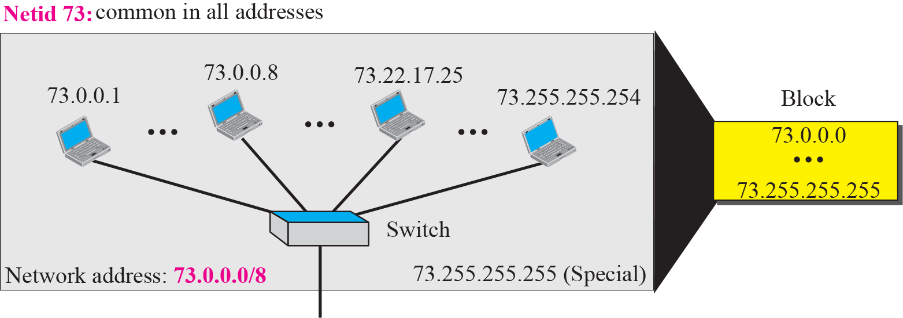
Solution to Example 5.13

Slide 49
Example 5.14
An address in a block is given as 180.8.17.9. Find the number of addresses in the block, the first address, and the last address.
Solution
Since 180 is between 128 and 191, the class is B and n is 16.
Next Figure shows a possible configuration of the network that uses this block.
1. The number of addresses in this block is N = 2^{32−n} = 65,536.
2. To find the first address, we keep the leftmost 16 bits and set the rightmost 16 bits all to 0s. The first address is 180.8.0.0/16, in which 16 is the value of n.
3. To find the last address, we keep the leftmost 16 bits and set the rightmost 16 bits all to 1s. The last address is
180.8.255.255.

Slide 50
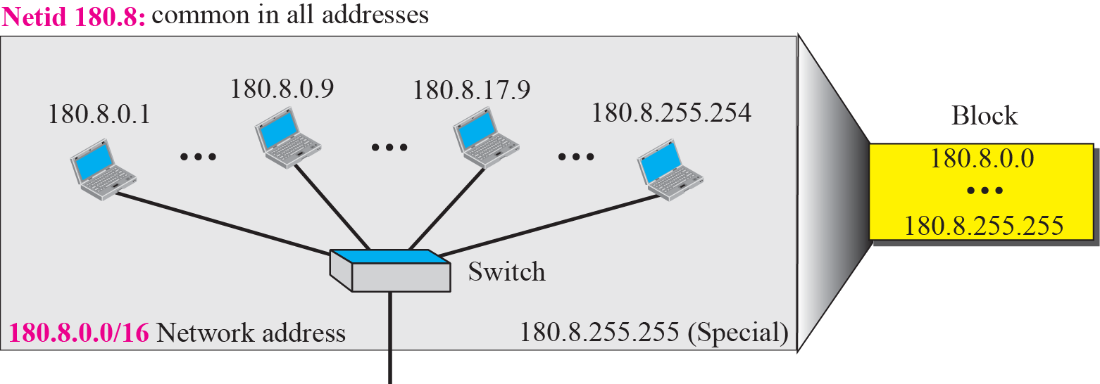
Solution to Example 5.14

Slide 51
Example 5.15
An address in a block is given as 200.11.8.45. Find the number of addresses in the block, the first address, and the last address.
Solution
Since 200 is between 192 and 223, the class is C and n is 24.
Next Figure shows a possible configuration of the network that uses this block.
1. The number of addresses in this block is N = 2^{32−n} = 256.
2. To find the first address, we keep the leftmost 24 bits and set the rightmost 8 bits all to 0s. The first address is
200.11.8.0/16, in which 24 is the value of n.
3. To find the last address, we keep the leftmost 24 bits and set the rightmost 8 bits all to 1s. The last address is
200.11.8.255/16.

Slide 52
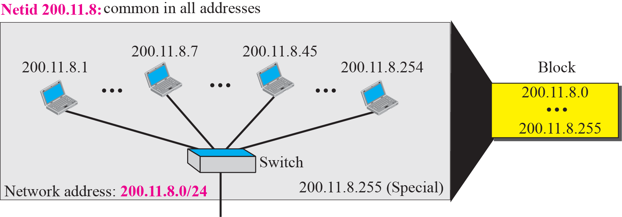
Solution to Example 5.15

Slide 53
An Example
Next Figure shows a hypothetical part of an internet with three networks
We have
  A LAN with network address 220.3.6.0 (Class C)
  A LAN with network address 134.18.0.0 (Class B)
  A switch WAN (Class C)

Slide 54
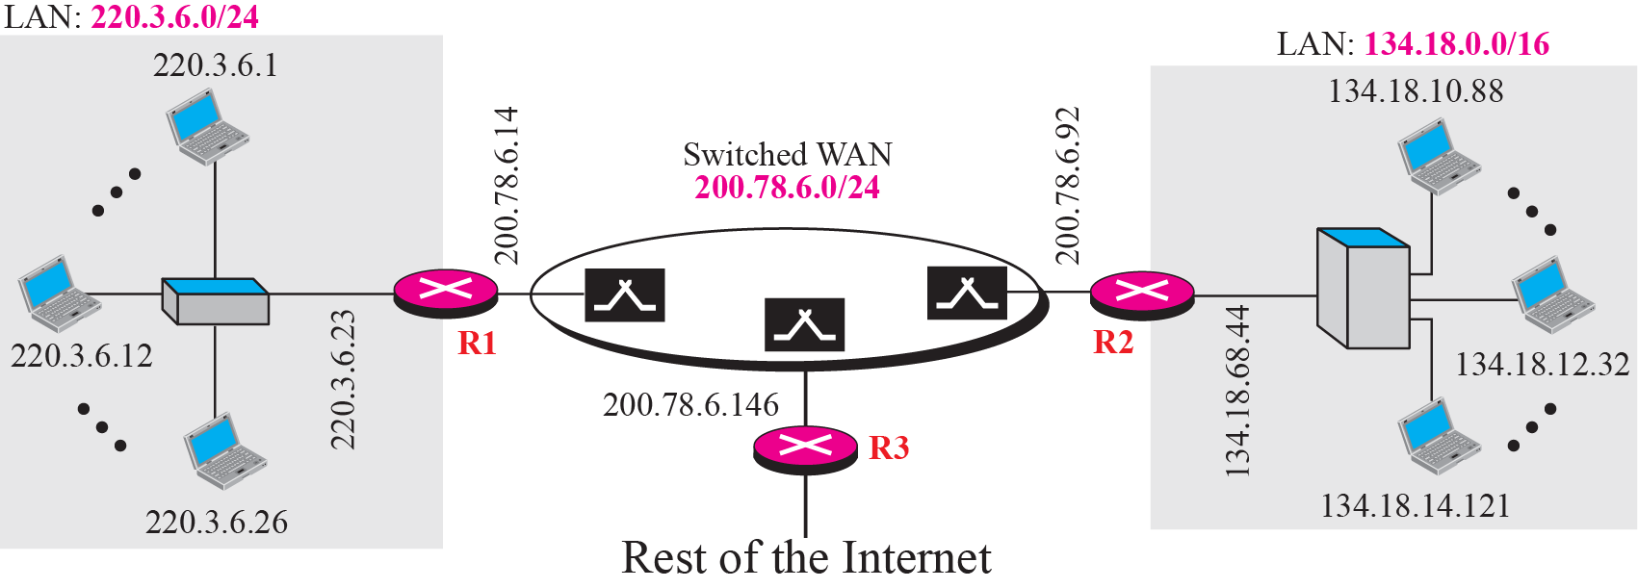
Sample internet

Slide 55
Network Addresses
The network address is the first address in a block
  Each network is identified by its network address
Routers route a packet based on the network address
  The network address defines the network to the rest of the Internet

Slide 56
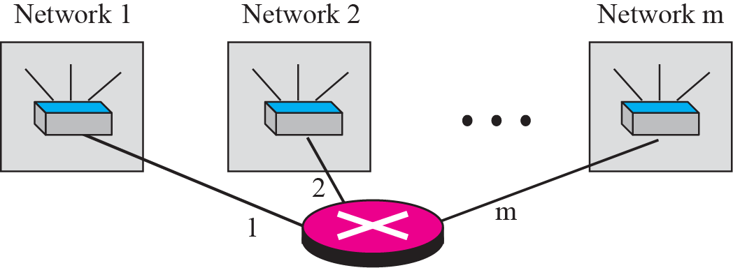
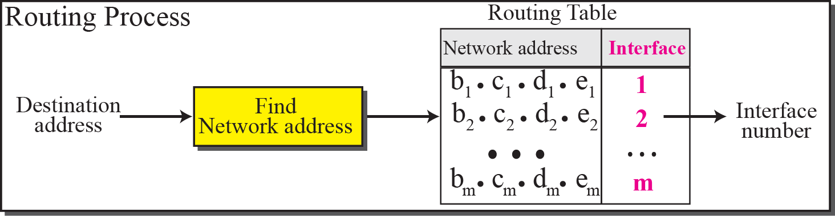
Network Addresses

Slide 57
Network Mask
Since routers route packets based on network address, routers need to know network address of the destination network
Solutions 1: from the destination address in the packet, we can extract the network address by
  First, find the class of the address
  Second, derive the netid and hostid
  Finally, network address is obtained by setting the hostid to zero.

Slide 58
Network Mask (Cont.)
Solutions 2: using network mask or default mask
  (Destination Address) AND (Default Mask) = Network address

Slide 59
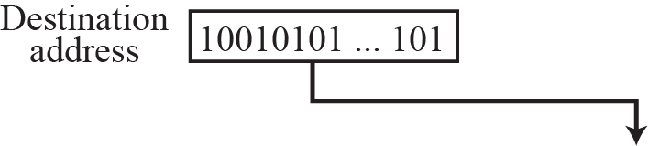
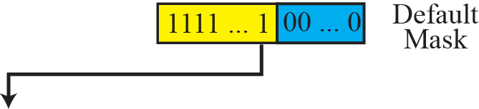
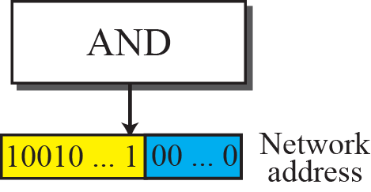
Finding a Network Address Using the Default Mask

Slide 60
Default Masks
Class A
  Mask in binary: 1111111 00000000 00000000 00000000
  Mask in dotted-decimal: 255.0.0.0
Class B
  Mask in binary: 11111111 11111111 00000000 00000000
  Mask in dotted-decimal: 255.255.0.0
Class C
  Mask in binary: 11111111 11111111 11111111 00000000
  Mask in dotted-decimal: 255.255.255.0

Slide 61
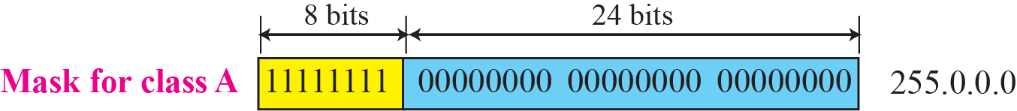
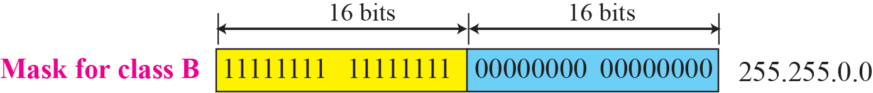
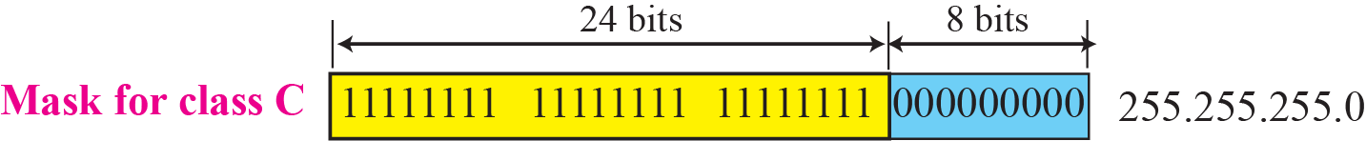
Network Mask

Slide 62
Example 5.16
A router receives a packet with the destination address 201.24.67.32. Show how the router finds the network address of the packet.
Solution
Since the class of the address is C, we assume that the router applies the default mask for class C, 255.255.255.0 to find the network address.
255
67

Slide 63
Three-Level Addressing: Subnetting
IP addresses are designed with two level of hierarchy
  However, two levels of hierarchy is not enough
We need more levels of hierarchy. Why?
  A block in class A or B may need to divided into several subnetworks
  An organization granted a class A or B could divide its block into smaller subblocks and share with other organizations

Slide 64
Three-Level Addressing: Subnetting (Cont.)
Solution: subnetting
  A network is divided into several smaller networks
  Each smaller network is called a subnetwork or a subnet
  Each subnetwork has its own subnetwork address

Slide 65
Example 5.17
Three-level addressing can be found in the telephone system if we think about the local part of a telephone number as an exchange and a subscriber connection:
in which 626 is the area code, 358 is the exchange, and 1301 is the subscriber connection.

Slide 66
Example 5.18
Next Figure shows a network using class B addresses before subnetting. We have just one network with almost 2^16 hosts. The whole network is connected, through one single connection, to one of the routers in the Internet. Note that we have shown /16 to show the length of the netid (class B).

Slide 67
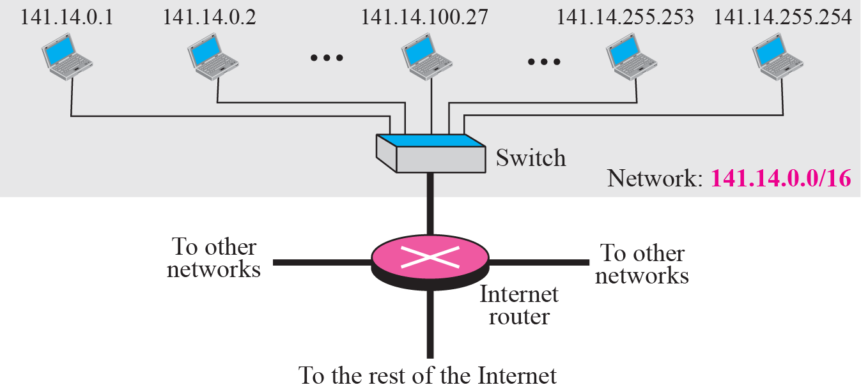
Example 5.18

Slide 68
Example 5.19
Next Figure shows the same network in Previous Figure after subnetting. The whole network is still connected to the Internet through the same router. However, the network has used a private router to divide the network into four subnetworks. The rest of the Internet still sees only one network; internally the network is made of four subnetworks. Each subnetwork can now have almost 214 hosts. The network can belong to a university campus with four different schools (buildings). After subnetting, each school has its own subnetworks, but still the whole campus is one network for the rest of the Internet. Note that /16 and /18 show the length of the netid and subnetids.

Slide 69
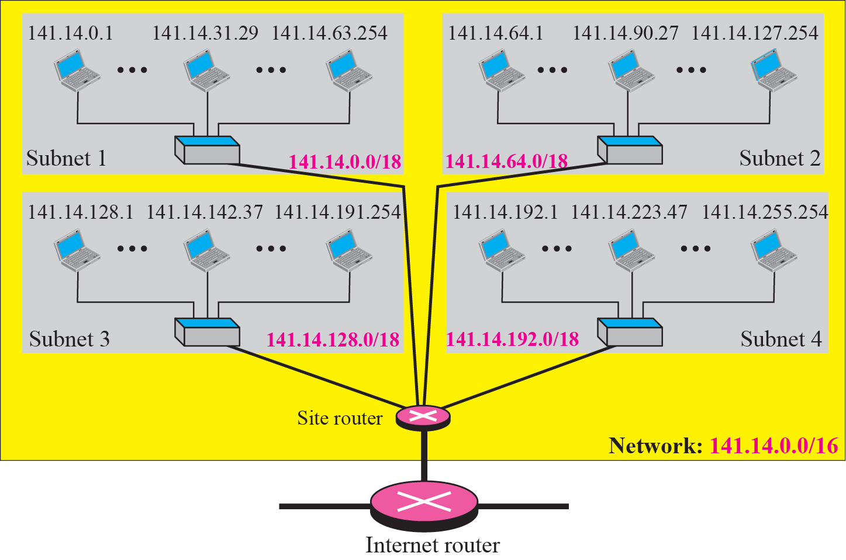
Example 5.19

Slide 70
Subnet Mask
The network mask create the network address
The subnet mask create the subnetwork address
Subnetting increases the length of the netid and decrease the length of hostid
If a network is divided into s subnetworks, each have equal numbers of hosts
  Then, n_{sub}=n + log₂s
  n = length of netid
  n_{sub}= length of a subnetid
  s = number of subnets, which must be a power of 2

Slide 71
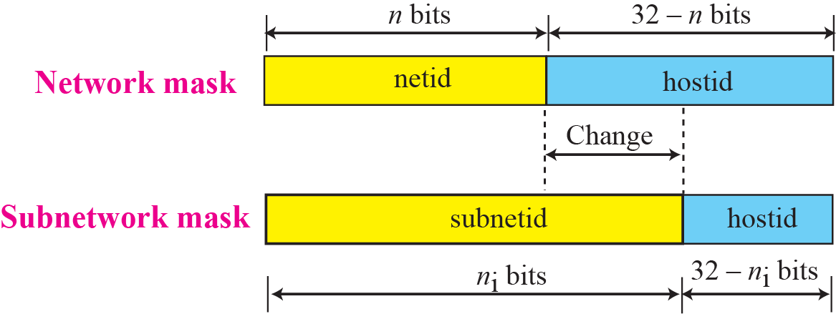
Network Mask and Subnetwork Mask

Slide 72
Example 5.20
In Example 5.19, we divided a class B network into four subnetworks. The value of n = 16 and the value of
n₁ = n₂ = n₃ = n₄ = 16 + log₂4 = 18.
This means that the subnet mask has eighteen 1s
and fourteen 0s. In other words, the subnet mask is 255.255.192.0 which is different from the network mask for class B (255.255.0.0).

Slide 73
Subnet Address
Subnet address: the first address in a subnet
  The identifier of the subnet
  Used by routers to route packets destined for that subnetwork
Given an IP address, we can find the subnet address in the same way as we found the network address
  AND the subnet mask to the address

Slide 74
Example 5.21
In Example 5.19, we show that a network is divided into four subnets. Since one of the addresses in subnet 2 is 141.14.120.77, we can find the subnet address as:

Slide 75
Supernetting
Class A and B addresses are almost depleted. However, class C addresses are still available
But, the size of class block, 256, is too small
Solution: supernetting
  Combine several class C blocks to create a larger range of addresses

Slide 76
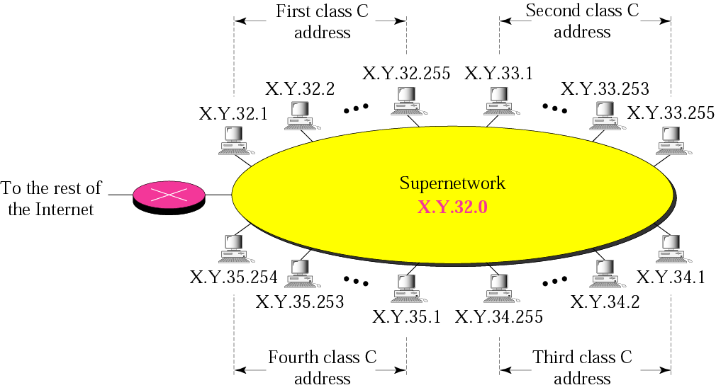
Figure 5-11
A Supernetwork
The McGraw-Hill Companies, Inc., 2000

Slide 77
Supernet Mask
A supernet mask is the reverse of a subnet mask
  A subnet mask has more 1s than the default mask
  A supernet mask has less 1s than the default mask
If several C network are combined into a supernet, n
  Then, n_{super}=n - log₂c
  n = length of netid
  n_{sub}= length of supernetid
  c = number of C blocks, which must be a power of 2

Slide 78
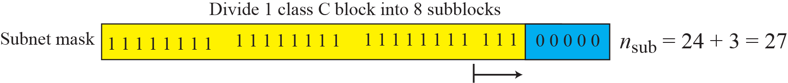
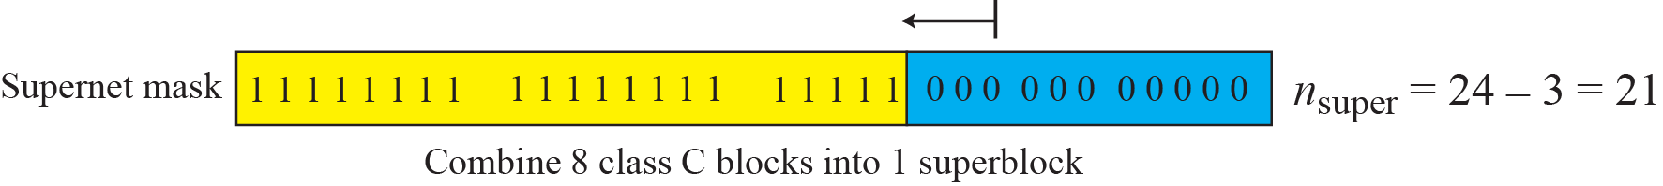
Figure 5-12
Comparison of Subnet, Default,
and Supernet Masks
The McGraw-Hill Companies, Inc., 2000

Slide 79
Supernetting (Cont.)
Supernetting creates two new problems
  The number of blocks to be combined must be a power of 2
    If an organization needs 7 blocks, we must allocate 8 blocks (address wasting)
  Supernetting and subnetting complicated the routing of packets

Slide 80
5.3
Classless Addressing
The McGraw-Hill Companies, Inc., 2000

Slide 81
Solutions to Address Depletion
Sol. 1. subnetting and supernetting
  Not really solve the problem and is complicated
Sol. 2: classless addressing
  Short-term solution
Sol. 3: IPv6
  Long-term solution

Slide 82
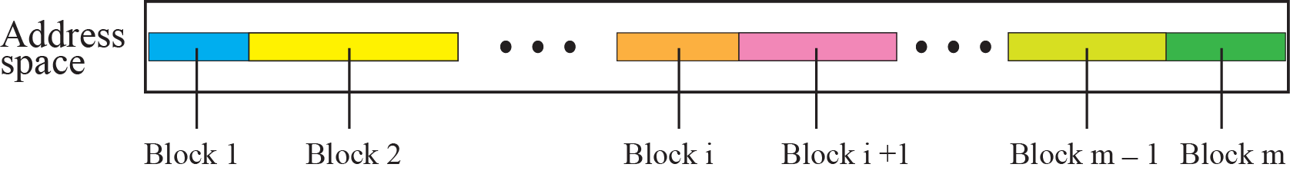
Variable-Length Blocks
The whole address space (2^32 addresses) is divided into variable length blocks

Slide 83
Two-Level Addressing: Prefix and Suffix
Prefix
  Another name for the common part of the address range
  Similar to the netid
Prefix length: the length of the prefix
  Equal to n in the slash notation
Suffix
  The varying part of the address range
  Similar to the hostid
Suffix length: the length of the suffix
  Equal to (32-n) in slash notation

Slide 84
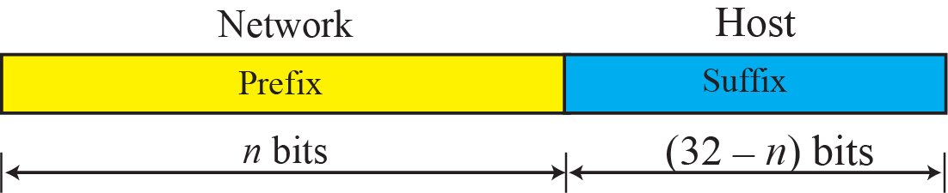
Prefix and Suffix

Slide 85
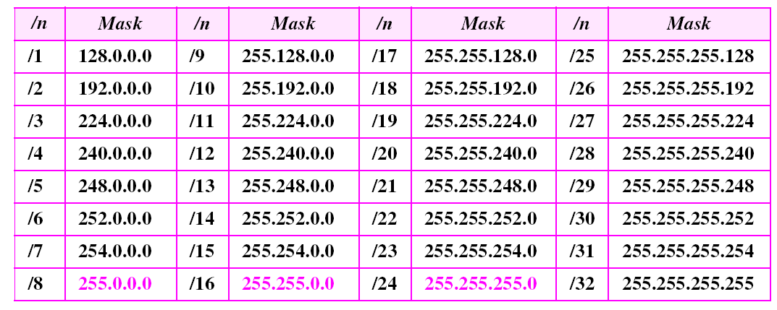
Prefix Lengths

Slide 86
Example 5.22
What is the prefix length and suffix length if the whole Internet is considered as one single block with 4,294,967,296 addresses?
Solution
In this case, the prefix length is 0 and the suffix length is 32. All 32 bits vary to define 2^32 = 4,294,967,296 hosts in this single block.

Slide 87
Example 5.23
What is the prefix length and suffix length if the Internet is divided into 4,294,967,296 blocks and each block has one single address?
Solution
In this case, the prefix length for each block is 32 and the suffix length is 0. All 32 bits are needed to define 2^32 = 4,294,967,296 blocks. The only address in each block is defined by the block itself.

Slide 88
Example 5.24
The number of addresses in a block is inversely related to the value of the prefix length, n. A small n means a larger block; a large n means a small block.

Slide 89
Slash Notation
Difference between classful and classless addressing
  In classful addressing, the netid length is inherent in the class
    Given an address, we know its class and thus its netid length (8, 16, 24)
  In classless addressing, the prefix length cannot be found if we are given only an address in a block
Thus, to define a block, in classless addressing, we need to know
  One of the address in the block
  The prefix length to define the block

Slide 90
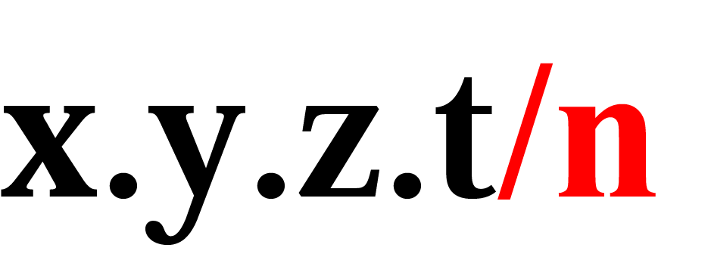
Slash Notation (Cont.)
Also called CIDR (Classless InterDomain Routing) notation
Attach the prefix length n to the end of a classless address

Slide 91
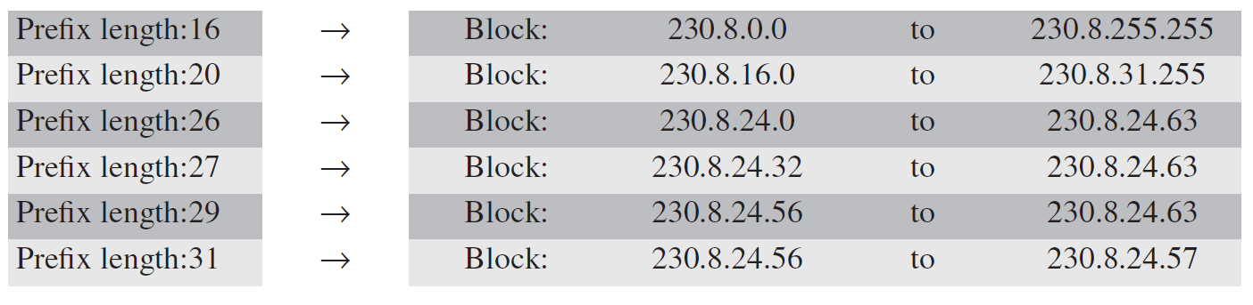
Example 5.25
In classless addressing, an address cannot per se define the block the address belongs to. For example, the address 230.8.24.56 can belong to many blocks some of them are shown below with the value of the prefix associated with that block:

Slide 92
Network Mask
Defined the same as in classful address
In classful addressing
  Network mask is implicit
However, in classless addressing
  Must use the slash notation

Slide 93
Example 5.26
The following addresses are defined using slash notations.
a. In the address 12.23.24.78/8, the network mask is 255.0.0.0. The mask has eight 1s and twenty-four 0s. The prefix length is 8; the suffix length is 24.
b. In the address 130.11.232.156/16, the network mask is 255.255.0.0. The mask has sixteen 1s and sixteen 0s.The prefix length is 16; the suffix length is 16.
c. In the address 167.199.170.82/27, the network mask is 255.255.255.224. The mask has twenty-seven 1s and five 0s. The prefix length is 27; the suffix length is 5.

Slide 94
Extracting Block Information
Slash notation contains all information we need about a block
Assume that , n is the prefix length
  The number of addresses: N = 2^{32-n}
  The first address (network address) in the block
  First address = (any address) AND (network mask)
  The last address in a block, two methods
    Add the number of addresses in the block minus 1 to the first address
    Keep the n leftmost bits of any address in the block and set the rightmost 32-n bits to 1s

Slide 95
Example 5.27
One of the addresses in a block is 167.199.170.82/27. Find the number of addresses in the network, the first address, and the last address.
Solution
The value of n is 27. The network mask has twenty-seven 1s and five 0s. It is 255.255.255.240.
a. The number of addresses in the network is 2^{32 − n} = 32.
b. We use the AND operation to find the first address (network address). The first address is 167.199.170.64/27.

Slide 96
Example 5.27 Continued
c. To find the last address, set the rightmost 32-n bits to 1s: The last address is 167.199.170.95/27.

Slide 97
Example 5.28
One of the addresses in a block is 17.63.110.114/24. Find the number of addresses, the first address, and the last address in the block.
Solution
The network mask is 255.255.255.0.
a. The number of addresses in the network is 2³² ⁻ ²⁴ = 256.
b. To find the first address, we use the short cut methods
discussed early in the chapter. The first address is
17.63.110.0/24.

Slide 98
Example 5.28 Continued
c. To find the last address, set the rightmost 32-n bits to 1s
. The last address is 17.63.110.255/24.

Slide 99
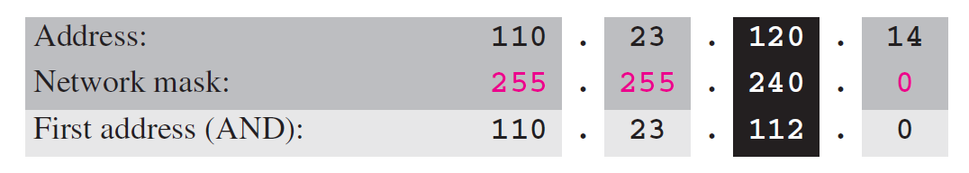
Example 5.29
One of the addresses in a block is 110.23.120.14/20. Find the number of addresses, the first address, and the last address in the block.
Solution
The network mask is 255.255.240.0.
a. The number of addresses in the network is 2³² ⁻ ²⁰ = 4096.
b. To find the first address, we apply the first short cut to bytes 1, 2, and 4 and the second short cut to byte 3. The first address is 110.23.112.0/20.

Slide 100
Example 5.29 Continued
c. To find the last address, set the rightmost 32-n bits to 1s
. The last address is 110.23.127.255/20.

Slide 101
Restrictions of Block Allocation
Number of Addresses in a Block
  The number of addresses in a block must be a power of 2
  Provide an integer value for the prefix length (see the next)
The value of prefix length can be found from the number of addresses in the block
  N = 2^{32-n}, then n = 32- log₂ N
Beginning Addresses
  The beginning address must be evenly divisible by the number of addresses.
    Ex: if a block contains 4 addresses, the beginning address must be divisible by 4.
    Can be prove that beginning address can be calculated as X x N (Skip!)

Slide 102
Example 5.30
An ISP has requested a block of 1000 addresses. The following block is granted.
a. Since 1000 is not a power of 2, 1024 addresses are granted (1024 = 2^10).
b. The prefix length for the block is calculated as n = 32 −
log₂1024 = 22.
c. The beginning address is chosen as 18.14.12.0 (which is
divisible by 1024).
The granted block is 18.14.12.0/22. The first address is 18.14.12.0/22 and the last address is 18.14.15.255/22.

Slide 103
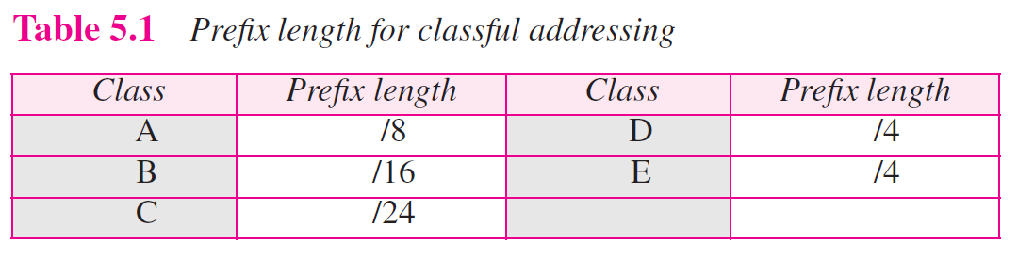
Relation to Classful Addressing
Classful addressing is a special case of classless addressing
  The prefix length of class A, B, and C are n_{A}= 8, n_{B} = 16, n_{C} = 24,

Slide 104
Example 5.31
Assume an organization has given a class A block as 73.0.0.0 in the past. If the block is not revoked by the authority, the classless architecture assumes that the organization has a block 73.0.0.0/8 in classless addressing.

Slide 105
Subnetting
We can also use subnetting with classless addressing
  Just increase the prefix length to derive the subnet prefix length

Slide 106
Designing Subnet
The number of addresses in each subnetwork should be a power of 2
The subnet prefix length should be found using
n_{sub}= n+log₂(N/N_{sub}),
where n_{sub} is the prefix length, N_{sub} is the number of addresses in a subnetwork
The starting address in each subnetwork should be divisible by the number of addresses in that subnet
See the following example

Slide 107
Note
The restrictions applied in allocating addresses for a subnetwork are
parallel to the ones used to allocate addresses for a network.

Slide 108
Example 5.32
An organization is granted the block 130.34.12.64/26. The organization needs four subnetworks, each with an equal number of hosts. Design the subnetworks and find the information about each subnetwork.
Solution
The number of addresses for the whole network can be found as N = 2³² ⁻ ²⁶ = 64. The first address in the network is 130.34.12.64/26 and the last address is 130.34.12.127/26. We now design the subnetworks:
1. We grant 16 addresses for each subnetwork to meet the first requirement (64/16 is a power of 2).
2. The subnetwork mask for each subnetwork is:

Slide 109
Example 5.32 Continued
3. We grant 16 addresses to each subnet starting from the first available address. Figure 5.30 shows the subblock for each subnet. Note that the starting address in each subnetwork is divisible by the number of addresses in that subnetwork.

Slide 110
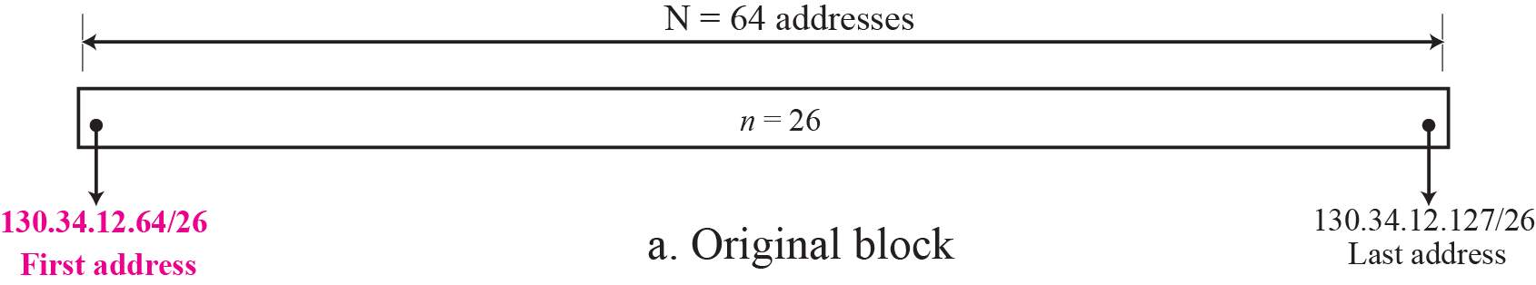
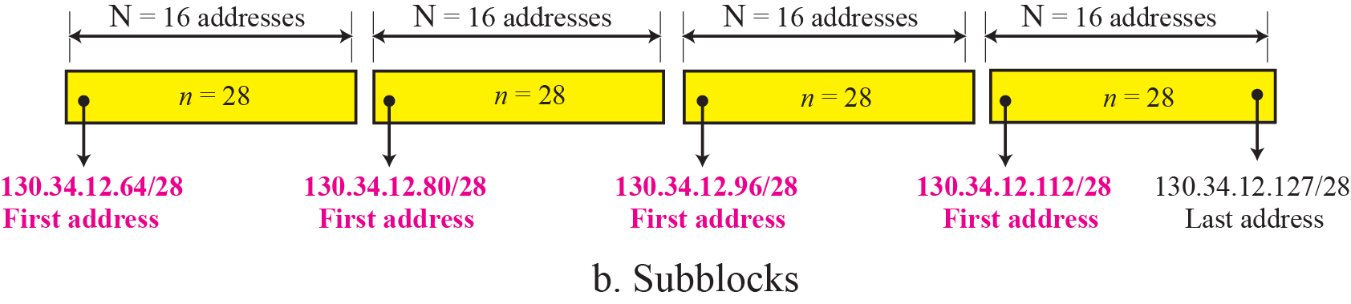
Figure 5.30 Solution to Example 5.32

Slide 111
Example 5.33
An organization is granted a block of addresses with the beginning address 14.24.74.0/24. The organization needs to have 3 subblocks of addresses to use in its three subnets as shown below:
❑ One subblock of 120 addresses.
❑ One subblock of 60 addresses.
❑ One subblock of 10 addresses.
Solution
There are 2³² ⁻ ²⁴ = 256 addresses in this block. The first address is 14.24.74.0/24; the last address is 14.24.74.255/24.
a. The number of addresses in the first subblock is not a power of 2. We allocate 128 addresses. The subnet
mask is 25. The first address is 14.24.74.0/25; the last
address is 14.24.74.127/25.

Slide 112
Example 5.33 Continued
b. The number of addresses in the second subblock is not a power of 2 either. We allocate 64 addresses. The subnet mask is 26. The first address in this block is 14.24.74.128/26; the last address is 14.24.74.191/26.
c. The number of addresses in the third subblock is not a power of 2 either. We allocate 16 addresses. The subnet mask is 28. The first address in this block is 14.24.74.192/28; the last address is 14.24.74.207/28.
d. If we add all addresses in the previous subblocks, the result is 208 addresses, which means 48 addresses are left in reserve. The first address in this range is 14.24.74.209. The last address is 14.24.74.255.
e. Figure 5.31 shows the configuration of blocks. We have shown the first address in each block.

Slide 113
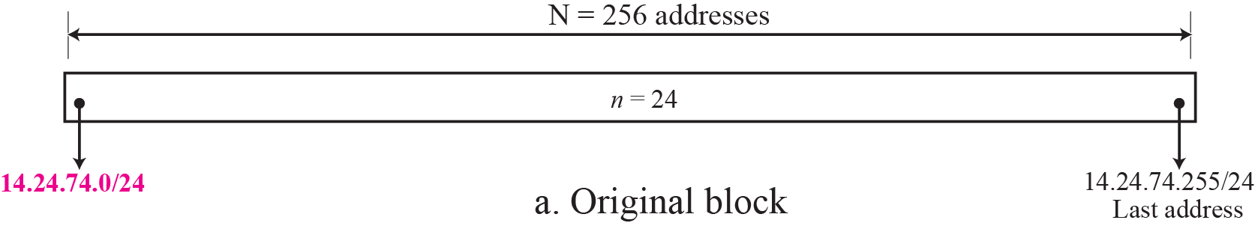
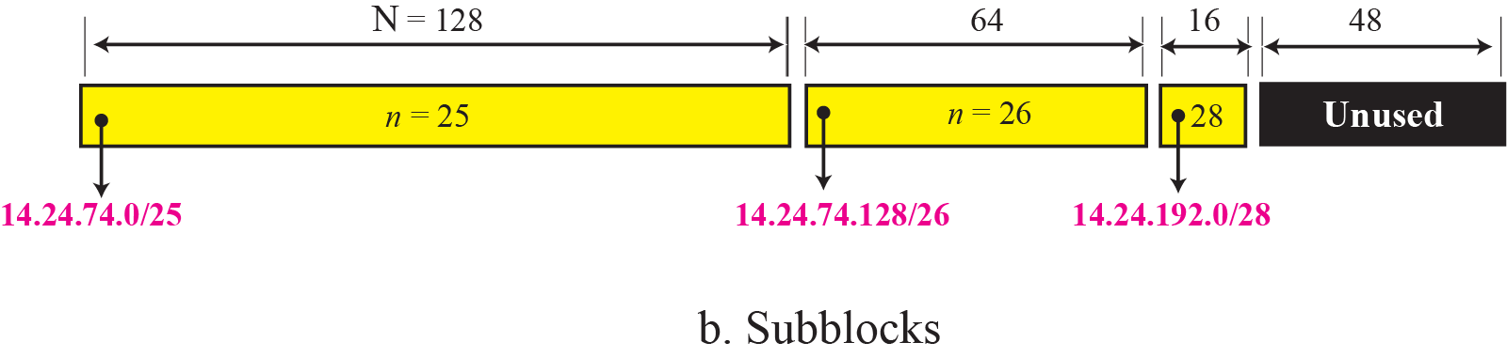
Figure 5.31 Solution to Example 5.33
14.24.74.192/28

Slide 114
Example 5.34
Assume a company has three offices: Central, East, and West. The Central office is connected to the East and West offices via private, WAN lines. The company is granted a block of 64 addresses with the beginning address 70.12.100.128/26. The management has decided to allocate 32 addresses for the Central office and divides the rest of addresses between the two other offices.
1. The number of addresses are assigned as follows:
2. We can find the prefix length for each subnetwork:

Slide 115
Example 5.34 Continued
3. Figure 5.32 shows the configuration designed by the management. The Central office uses addresses 70.12.100.128/27 to 70.12.100.159/27. The company has used three of these addresses for the routers and has reserved the last address in the subblock. The East office
uses the addresses 70.12.100.160/28 to 70.12.100.175/28. One of these addresses is used for the router and the company has reserved the last address in the subblock. The West office uses the addresses 70.12.100.160/28 to 70.12.100.175/28. One of these addresses is used for the router and the company has reserved the last address in the subblock. The company uses no address for the point-to-point connections in WANs.

Slide 116
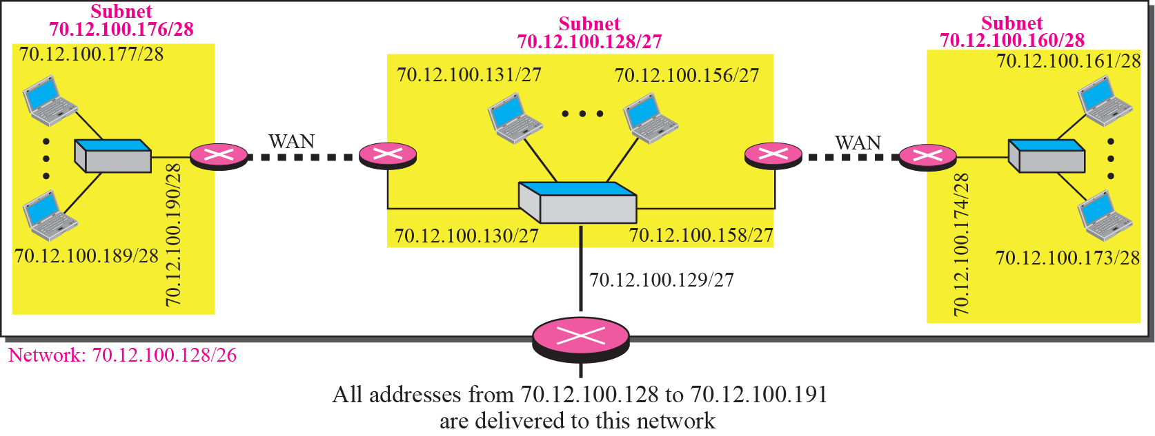
Figure 5.32 Example 5.34

Slide 117
Address Aggregation
How are the blocks allocated in classless addressing?
  By the Internet Corporation for Assigned Names and Addresses (ICANN)
However, ICANN does not allocate addresses to individual organization
  It assigns a larger block to an ISP
  Then ISP divided its assigned block into smaller subblocks to its customers
Address aggregation: many blocks of addresses are aggregated in one block and granted to one ISP
  Details are discussed in Chapter 6

Slide 118
Example 5.35
An ISP is granted a block of addresses starting with 190.100.0.0/16 (65,536 addresses). The ISP needs to distribute these addresses to three groups of customers as follows:
❑ The first group has 64 customers; each needs approximately 256 addresses.
❑ The second group has 128 customers; each needs
approximately 128 addresses.
❑ The third group has 128 customers; each needs approximately 64 addresses.
We design the subblocks and find out how many addresses are still available after these allocations.

Slide 119
Example 5.35 Continued
Solution
Let us solve the problem in two steps. In the first step, we allocate a subblock of addresses to each group. The total number of addresses allocated to each group and the prefix length for each subblock can found as
Figure 5.33 shows the design for the first hierarchical level. Figure 5.34 shows the second level of the hierarchy. Note that we have used the first address for each customer as the subnet address and have reserved the last address as a special address.

Slide 120

Figure 5.33 Solution to Example 5.35: first step

Slide 121



Figure 5.34 Solution to Example 5.35: second step

Slide 122
5.4
Special Addresses
The McGraw-Hill Companies, Inc., 2000

Slide 123
Special Blocks
Some blocks of addresses are reserved for special purposes
  All-zeros Addresses
  Limited Broadcast Address
  Loopback Address
  Private Addresses
  Multicast Addresses

Slide 124
All-Zeros Address
The block 0.0.0.0/32 contains only one address
Used by a host at bootstrap time when it does not know its IP address
Send a packet to a DHCP server, using
  Source address: all 0s
  Destination address: limited broadcast address

Slide 125

Figure 4-16
Example of Using the All-Zero Address
The McGraw-Hill Companies, Inc., 2000

Slide 126
All-Ones Address: Limited Broadcast Address
The block 255.255.255.255/32 contains only one address
Used by a host to send a packet to every other host in a network
Routers will block a packet having this type of address to other networks

Slide 127
Figure 4-15
Example of Limited Broadcast Address
The McGraw-Hill Companies, Inc., 2000

Slide 128
Loopback Address
The block 127.0.0.0/8
This packet never leaves the machine
Used only as a destination address

Slide 129
Figure 4-18
Example of Loopback Address
The McGraw-Hill Companies, Inc., 2000

Slide 130
Private Addresses
A number of blocks are assigned for private use and not recognized globally.
Used in
  Isolation
  In connection with network address translation

Slide 131
Multicast Addresses
The block 224.0.0.0/4 is reserved for multicast communication

Slide 132
Special Addresses in Each Block
Network Address
  First address in a block
Direct Broadcast Address

Slide 133
Direct Broadcast Address
The subfix set all to 1
The last address in a block or subblock
Used by a router to send a packet to all hosts in a specific network
Can only be used as a destination address

Slide 134
Figure 4-14
Example of Direct Broadcast Address
The McGraw-Hill Companies, Inc., 2000

Slide 135
5.5
NETWORK ADDRESS
TRANSLATION
(NAT)
The McGraw-Hill Companies, Inc., 2000

Slide 136
Network Address Translation (NAT)
Allow
  A set of private addresses for internal communication
  A set of (at least one) global Internet addresses for communication with another site
From the next slide
  The private network uses private addresses
  The NAT router uses one private address and one global address
    The rest of the Internet sees only the NAT router with the address 200.24.5.8

Slide 137

Figure 30-6
NAT
The McGraw-Hill Companies, Inc., 2000

Slide 138
Address Translation
NAT
  Replaces the source address of all outgoing packets with the global NAT address
  Replace the destination address of all incoming packets with the appropriate private address

Slide 139
Figure 30-7
Address Translation
The McGraw-Hill Companies, Inc., 2000

Slide 140
Translation Table
Used by the NAT to drive the destination address for a packet coming from the Internet
Three approaches
  Using one IP address
  Using a Pool of IP addresses
  Using Both IP addresses and Port numbers

Slide 141
Using One IP Address
The translation table has only two columns
  The private address
  The external address (destination address of the packet)
When the router translates the source address of the outgoing packet
  It also make note of the destination address, where the packet is going

Slide 142

Figure 30-8
Translation
The McGraw-Hill Companies, Inc., 2000

Slide 143
Using One IP Address (Cont.)
Communication must always be initiated by the private network
Thus, a private network cannot run a server program if it is using NAT technology

Slide 144
Using a Pool of IP Addresses
Only one global address allows only one private-network host to access the same external host
  Not allow two private-network hosts accessing the same external host
Solution: using a pool of IP addresses
For example, if the NAT can use four address
  Four private-network hosts can communicate with the same external host at the same time

Slide 145
Using a Pool of IP Addresses (Cont.)
Drawbacks
  No more than four connections can be made to the same destination
  Need a pool of IP addresses

Slide 146
Using Both IP Addresses and Port Numbers
Use only one IP address and allow a many-to-many relationship between private-network hosts and external server programs
  We need more information in the translation table
When the response comes back, the combination of source address (25.8.3.2) and destination port number (1400) define the private network host

Slide 147
Five-Column Translation Table

Slide 148
Using Both IP Addresses and Port Numbers
Thus, for this translation to work, the temporary port number (1400 and 1401) must be unique

Slide 149
範圍：CHAPTER 1~5
日期：10/28
第一次考試

